Slide 1
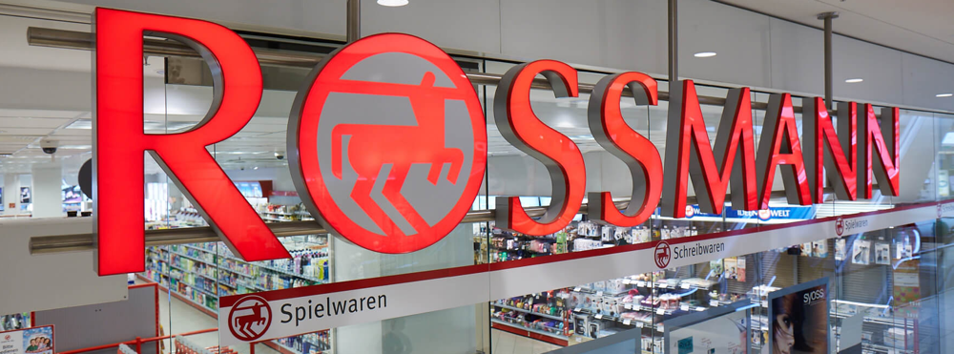
Sales Forecasting for Rossmann Drug Company
Li Cao
Radhika Singh Ghelot
Sapna Mishra
Yiyan (James) Wan
Notes:
hello!

Slide 2

Agenda
Business background and problem statement
Assumptions
Data preparation and EDA
Modeling techniques and approaches
Results summary and R Shiny demo
Conclusion and outlook

Slide 3
Business background and problem statement
Background:
Drug store chain with 3,000 drug stores in 7 European countries.
Considering to be acquired by a potential business buyer.
Problem statement:
How to provide an efficiently and accurately sales forecast for the next four weeks after acquisition date for each individual store?
Notes:
As internal data science team at Rossmann, we are engaged to help COO to coordinate with individual store managers to provide a prediction of total sales for each store for 4 weeks ahead.

Slide 4
General Assumptions
Positioning ourselves on June 30, 2015 now and forecasting sales for next four weeks
Each individual store are operating independently and no interaction effect with other stores.
Comparing to the individual store using Auto.Arima as the “baseline” and using Auto.Arima for ease of parameterization across many models.
Notes:
As internal data science team at Rossmann, we are engaged to help COO to coordinate with individual store managers to provide a prediction of total sales for each store for 4 weeks ahead.

Slide 5
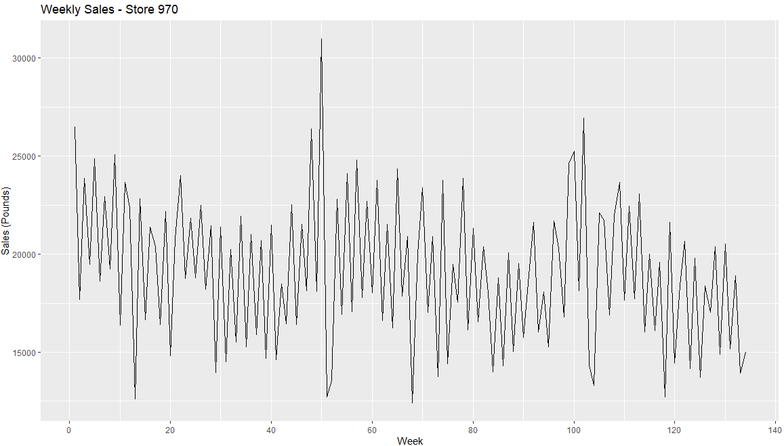
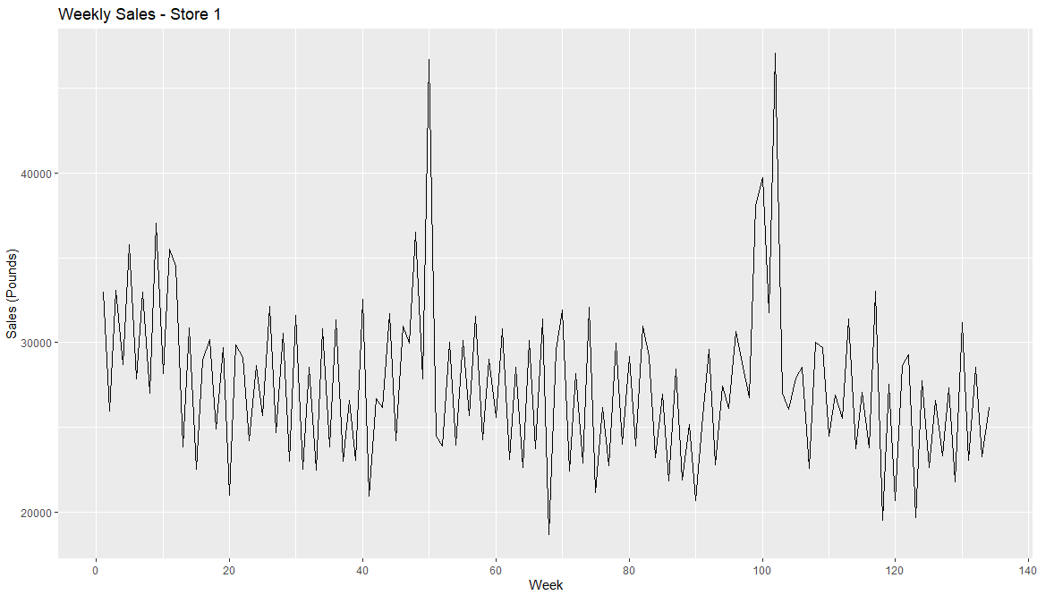
Data Properties & Transformations
Data Properties:
Data was procured from Kaggle Website.
Daily Sales Data for 1115 Rossmann Stores.
~10.2MM records.
Data Transformations & Exclusions:
180 stores were excluded from the analysis.
Daily sales data was aggregated to weekly sales data.
Forecasting for 935 unique stores.
Final Dataset Records - ~851K
Training Data from Jan 2013 - June 2015
Forecast 4 weeks of Sales from 5th of July 2015 - 26th of July 2015

Slide 6
Proposed Models
We will evaluate dimensionality-reduction-based modelling and Hierarchical clustering approaches to forecast the next 4 weeks of each store
Singular Value Decomposition
(SVD)
Independent Component Analysis
(ICA)
Non-Negative Matrix Factorization
(NMF)
Hierarchical
(HTS)
Auto Arima
Auto Arima
Auto Arima
Auto Arima
TSLM
Middle Out
Bottom Up
Prophet
Arima (with Grid Search)
Top Down
Optimal Combination

Slide 7
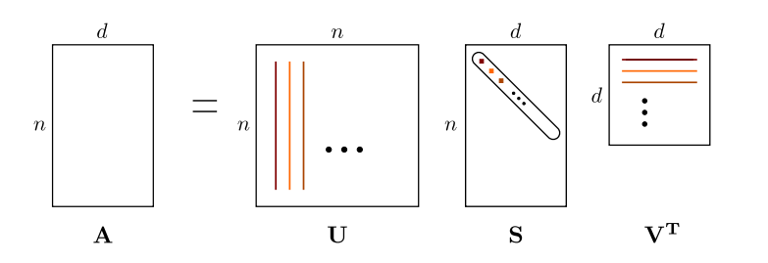
Singular Value Decomposition
To reduce the 935 stores to a lower-dimensionality representation, we performed Singular Value Decomposition to then identify principal components to represent our data.
SVD decomposes a matrix A (dim nxd) into:
matrix U with columns of left singular vectors (nxn)
matrix V with columns of right singular vectors (dxd), and
diagonal matrix S of the singular values of A (nxd) such that A = UᐧSᐧV^{T}
Note: In R, svd() returns a vector labeled d representing diagonal of S, not the full S
Notes:
As internal data science team at Rossmann, we are engaged to help COO to coordinate with individual store managers to provide a prediction of total sales for each store for 4 weeks ahead.

Slide 8
SVD – Component Analysis
After calculating the U, S, V of the SVD, we need to choose the principal components to forecast
The matrix of principal component columns is calculated as UᐧS (dim nxd)
Analyzing the explained variance ratio of these components with a scree plot of d, we identify that the first 3 components account for 99% of the total variance of the data set.
Now we can use the first 3 principal component columns of UᐧS as the time series to forecast.
Notes:
As internal data science team at Rossmann, we are engaged to help COO to coordinate with individual store managers to provide a prediction of total sales for each store for 4 weeks ahead.

Slide 9
Recomposing the original Time Series
After forecasting the first 3 columns of UᐧS, we need to recompose the principal component forecasts back to the 935 stores sales.
The UᐧS matrix is extended by the h steps forecasted
The forecasted values are placed in the first 3 columns of the n+1 to n+h rows.
The remaining values of the forecasted rows are filled with the values from the nth (last known) row.
The original A (plus forecast) is then reconstructed with the dot product A = UᐧSᐧV^{T}
Final outcome : 134 rows (representing the time series Jan 2013 to July 2015) and 935 columns(fitted + forecasted values for the 935 stores)
Notes:
As internal data science team at Rossmann, we are engaged to help COO to coordinate with individual store managers to provide a prediction of total sales for each store for 4 weeks ahead.

Slide 10
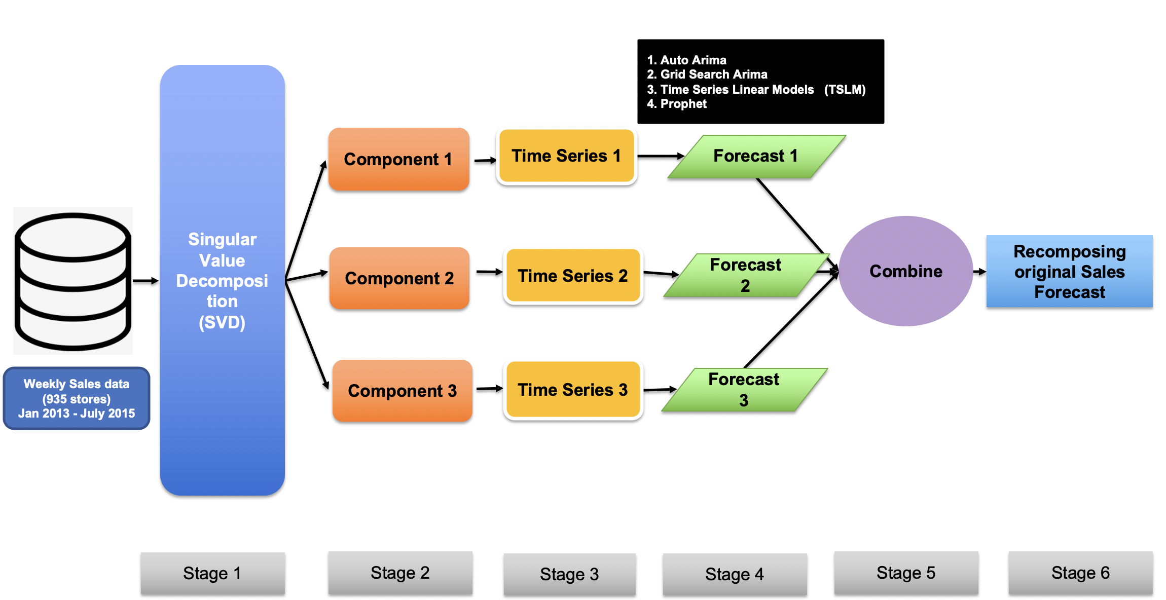

SVD Modeling Architecture
1. Auto Arima
2. Grid Search Arima
3. Time Series Linear Models (TSLM)
4. Prophet
Singular Value Decomposition
(SVD)
Component 1
Time Series 1
Forecast 1
Combine
Component 2
Time Series 2
Recomposing original Sales Forecast
Forecast 2
Weekly Sales data (935 stores)
Jan 2013 - July 2015
Component 3
Time Series 3
Forecast 3

Slide 11
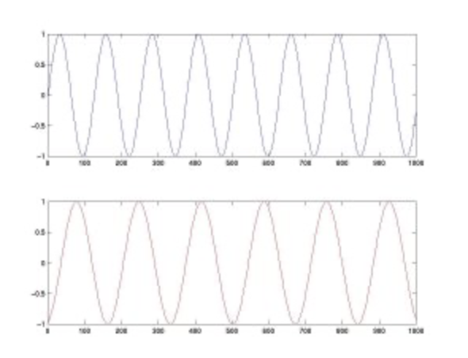
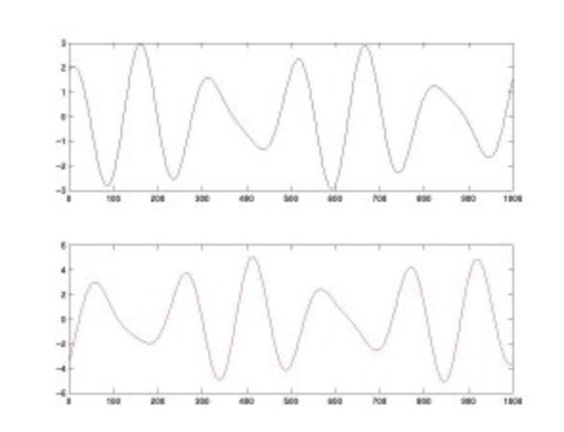
Independent Component Analysis
Finding the right Source of an information mix: method to separate independent sources linearly mixed in several sensors, separating out artifacts embedded in the data
A
A – 2B
B
1.7A -B
ICA Decomposition
Unmixing Matrix
SOURCE: A
SOURCE: B
Notes:
ICA is essentially a method of finding the source of an information mix given to us, it tries to identify the independent source which seperates out mix of information in the data
Like we see in the example where we have source A and Soucr B that combine to give two type of series: a-2b and 1-.7 a –b
What Ica does is it estimates that unmixing matrix which will seperate out the two sources procduing these series, in our case: 935 stores

Slide 12
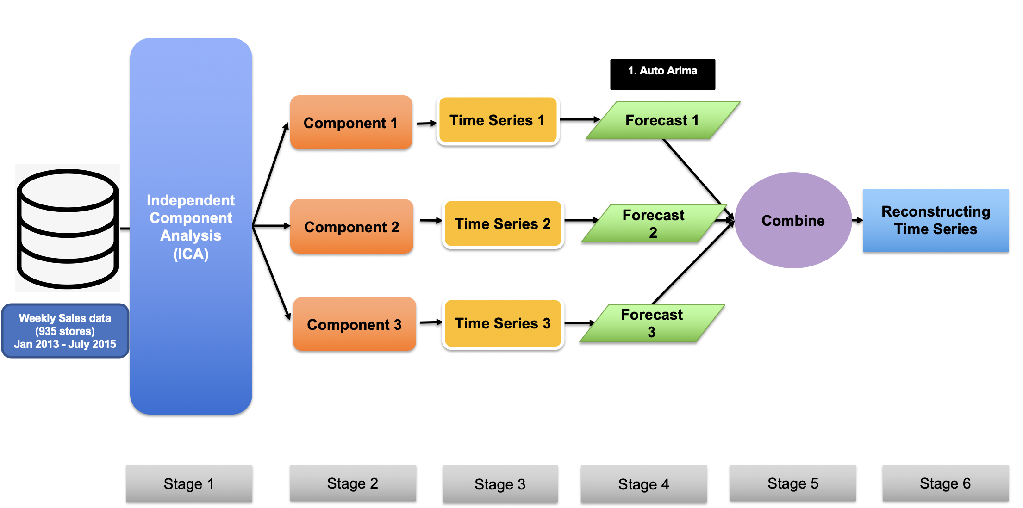
ICA Modeling Architecture
Reconstruction Methodology
Forecast
R:
fastICA
Mixing Matrix:
[3 x 935]
Component 1
935 Forecasted Stores:
[130 x 935]
Unmixing Matrix
Source Matrix
Component 2
Matrix:
[130 x 3]
Component 3
Notes:
Here we see that ICA allows us to get 3 components which are converted to time series and forecasted, post which they are reconstructed back to give us the series for all 935 stores:
Reconstruction : fastica estimates the unmixing matrix, gets the sources matrix, which gives 3 components, which are put together 130x3 matrix, Matrix multiplied by mixing matrix 3x935 to get final 935 store series

Slide 13
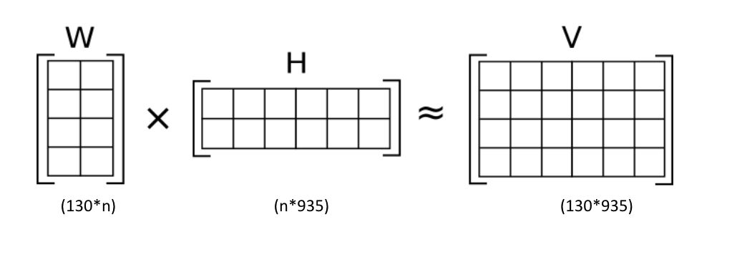
Non-negative matrix factorization (NMF)
Property: A group of algorithms in multivariate analysis and linear algebra where a matrix V is factorized into two matrix W an H with property that all three matrices have no negative elements
Motivation: NMF returns non-negative elements compared to ICA
* V is input matrix with 130 rows and 935 columns where date are in rows and stores weekly sales are in columns
* Use NMF to find n=10 features in order to generate a features matrix W with 130 rows and 10 columns and a coefficients matrix H with 10 rows and 935 columns.
Notes:
The Non-0negative matrix factorization works similar to SVD and ICA, they all do the linear algebra to reduce the dimensionality, but different from SVD and ICA, NMF uses an alternative approach to decompose that assumes that the data and the components are non-negative. This is our motivation why we use NMF after we seeing ICA returns us negative components in our case as Radi mentioned before.
As you can see from the graph, V is our input matrix, it is a panel data with date and individual stores, NMF works for us by finding a decomposition of our raw data matrix V into two matrices W and H of non-negative elements, by optimizing the distance d between V and the matrix product WH.

Slide 14
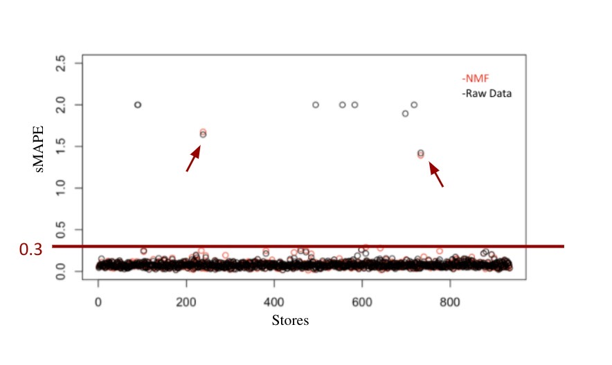
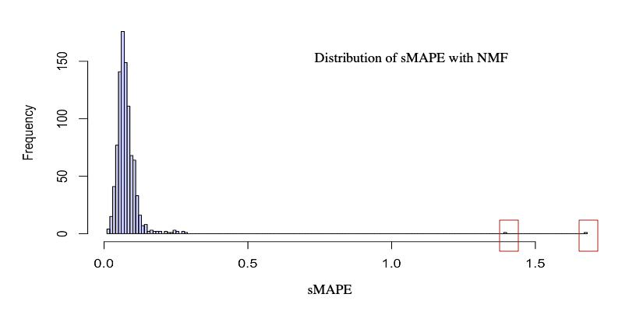
Non-negative matrix factorization (NMF)
Results: return a more stable general predictions

Slide 15
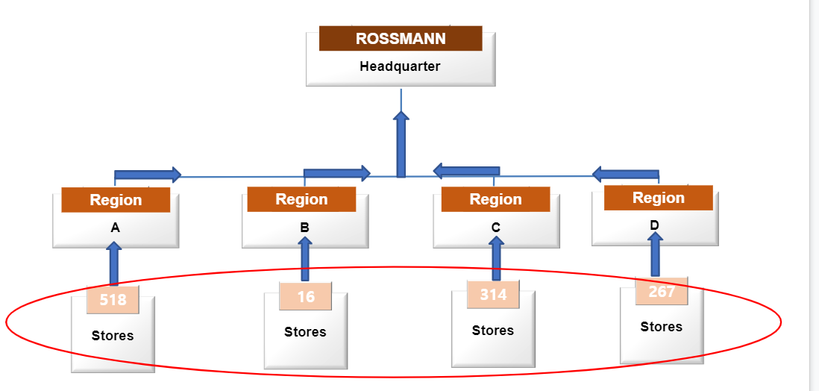
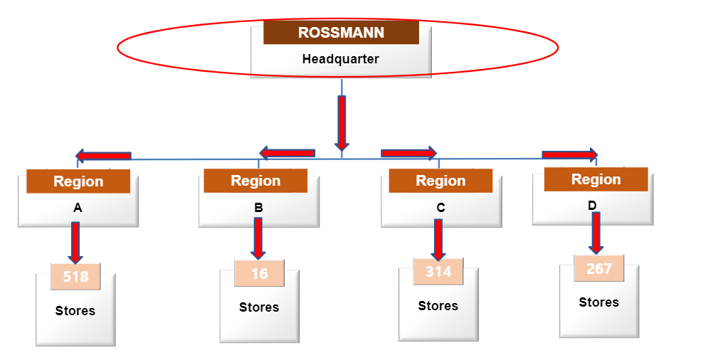
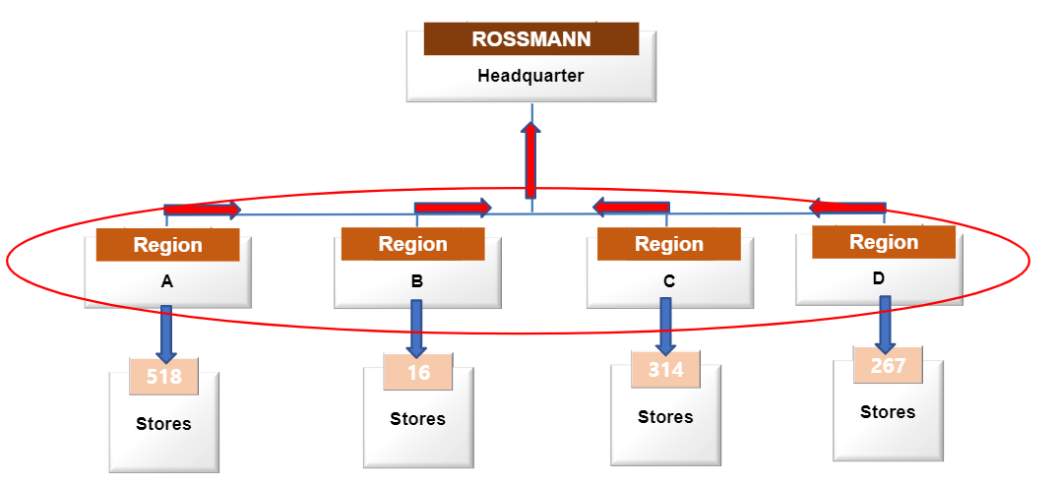
Hierarchical time series (HTS):
Bottom-Up/Top-Down/ Middle-Out
Methods applicable to Rossmann because of its regional hierarchical structure.
Bottom-Up
Top-Down
Middle-Out
Notes:
Forecast from individual store from below and aggregate all the way up
Generating coherent forecasts allowing individual time series to be forecast individually, but preserving the relationships within the hierarchy.

Slide 16










Hierarchical time series (HTS):
Optimal Combination
ROSSMANN
Headquarter
Region
Region
Region
Region
Region
Region
Region
A
B
C
D
518
16
314
267
Stores
Stores
Stores
Stores
Notes:
All the 3 approaches mentioned above only really forecast one level of the hierarchy, but the optimal combination approach forecasts independently at all levels, using all the information and relationships a hierarchy can offer.
This method is based on independently forecasting all series at all levels of the hierarchy and then using a regression model to optimally combine and reconcile these forecasts. The resulting revised forecasts add up appropriately across the hierarchy, are unbiased and have minimum variance amongst all combination forecasts under some simple assumptions.

Slide 17

Demonstration on Shiny platform

Slide 18
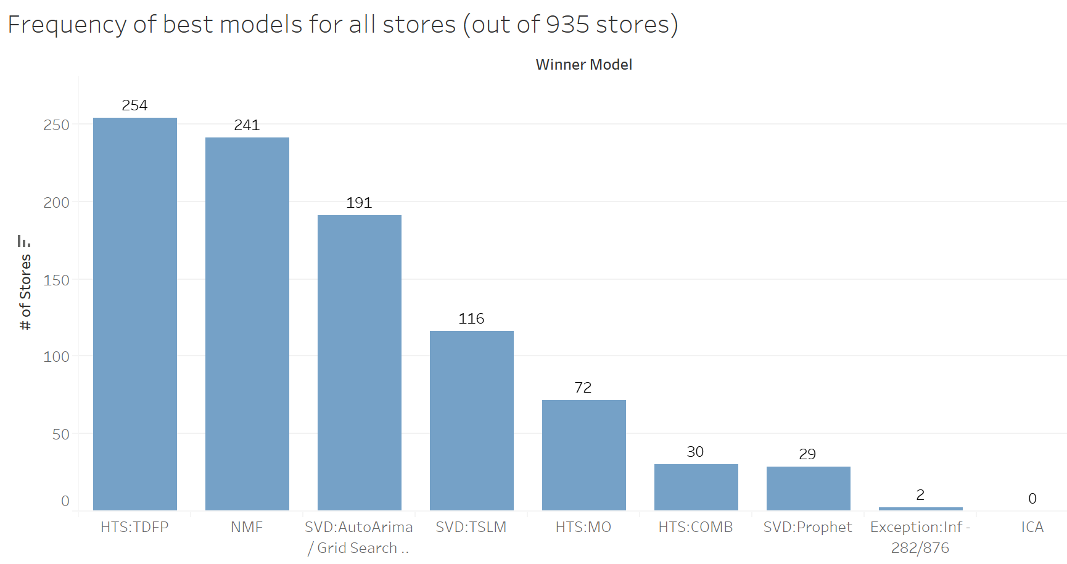
Evaluation metrics and summary
Notes:
as a result, our technique ensures all stores have its winner model, so here is the distribution of number of stores for each winner models

Slide 19
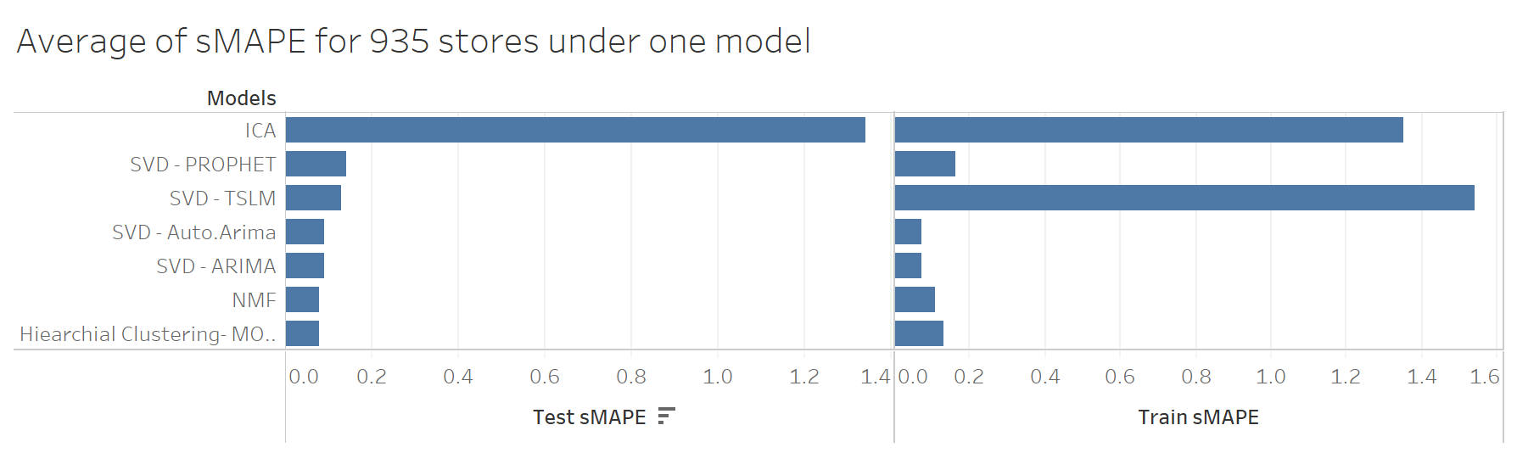
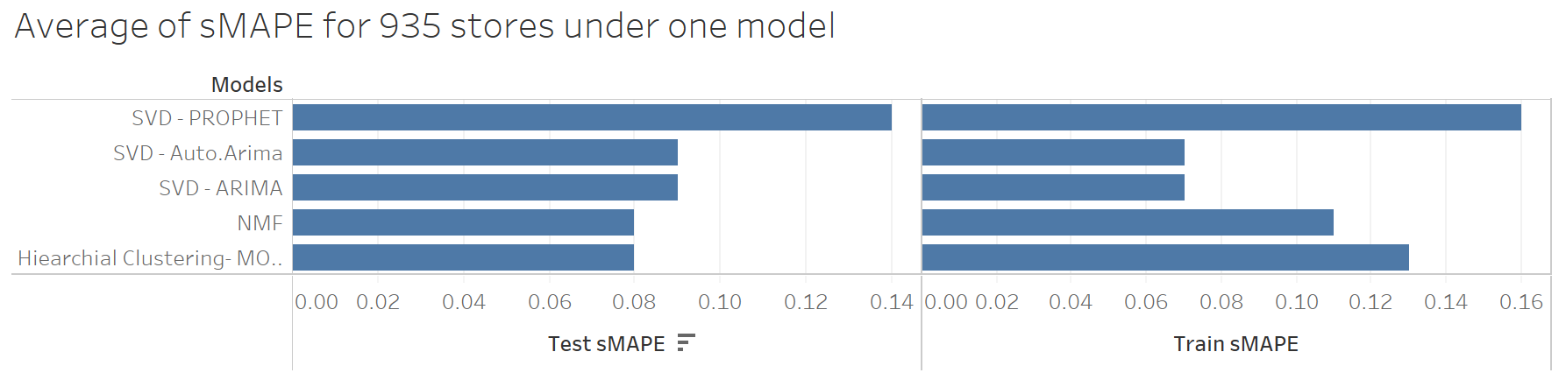
Evaluation metrics and results summary
With ICA and SVD - TSLM
Without ICA and SVD - TSLM
Notes:
as a result, our technique ensures all stores have its winner model, so here is the distribution of number of stores for each winner models

Slide 20
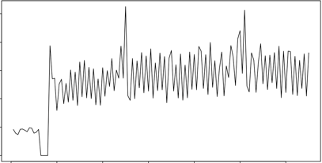
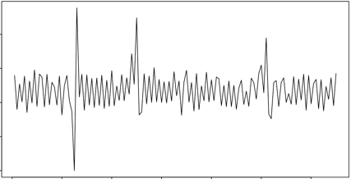
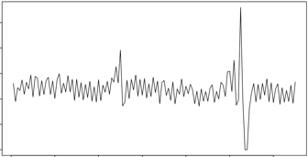
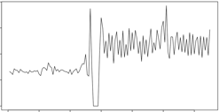
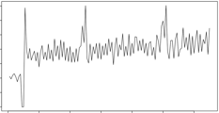
Future work and outlook
1.ARFIMA
2. Build intervention models for the 180 excluded stores.
3. ICA reconstruction for time series needs deeper research and development, due to availability of sparse material online, further research would need more formal advisory and administrative support to source patented material online.
Raw Data | Store 589 | Store 665 | Store 699 | Store 837 | Store 861
Arima sMAPE | 2.000 | 2.000 | 2.000 | 1.895 | 2.000
Arfima sMAPE | 0.136 | 0.073 | 0.103 | 0.060 | 0.064
Notes:
as a result, our technique ensures all stores have its winner model, so here is the distribution of number of stores for each winner models

Slide 21
Thank You!

Slide 22

Appendix – Team Contribution
Tasks | Owner
Data Cleansing & EDA | Sapna/Yiyan/Li
Clustering approach (Abandoned) | Sapna/Yiyan/Li
SVD - Auto.Arima/Arima/TSLM/Prophet | Sapna
HTS- MO/TD/BU/OC/Auto.Arima | Yiyan
NMF - ARFIMA/TBATS/Auto.Arima | Li
ICA | Radhika
Shiny app/Tableau visualization | Sapna/Yiyan
Powerpoint slides | All

Slide 23
References
https://www.kaggle.com/c/rossmann-store-sales/overview
SVD Linear algebra - https://www.youtube.com/watch?v=cOUTpqlX-Xs

Slide 24
Forecasting Individual Stores
- Why not model individual stores?
That would require 935 individual univariate time series models!.
- We will use the individual store Auto.Arima to benchmark our alternative approaches of dimensionality -based reduction techniques (SVD,ICA,NMF) and Hierarchical clustering

